Slide 1
Formalities Office
Your Formalities Made Simple
Founded by Claudine Dahan

Slide 2

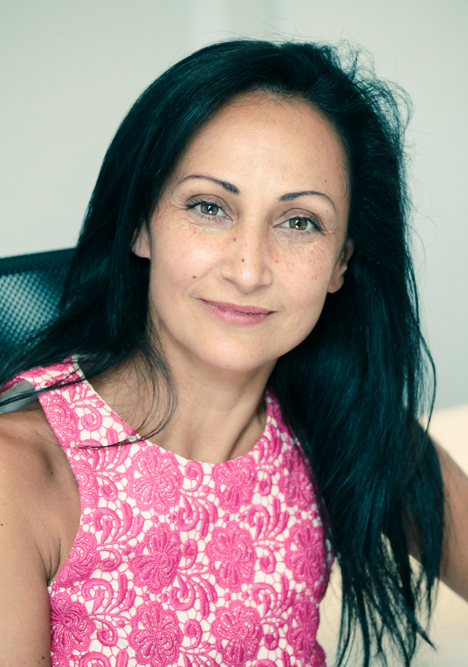

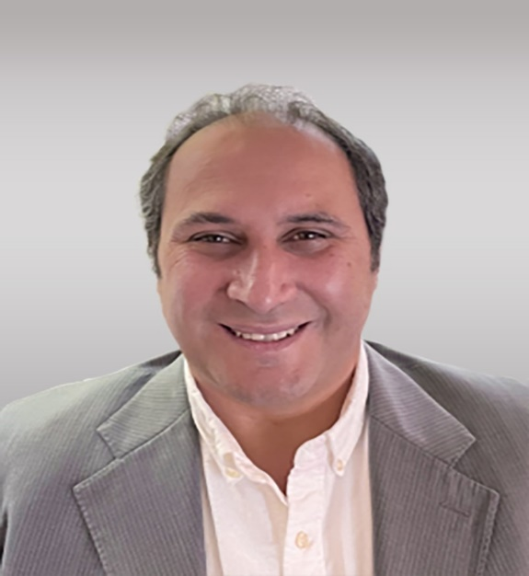


THE OFFICE
“ Our Experience is at your Service.
Our Offices specialize in administrative and legal formalities in Europe and in the US.
Founded in 1995 by Claudine Dahan, we have earned our clients’ trust and confidence with more than 40 years of reliable service to prestigious law firms, CPA firms and Institutional entities.
Today, Sabine Dahan, President of the company, is surrounded by a professional and competent team.
Sabine DAHAN - CEO
PROFESSIONAL
EXPEDIENT
TRUSTWORTHY
Lionel DAHAN Financial Director

Slide 3



ORGANISATION
“
Today and Tomorrow, SAB Formalities Facilitates the Global Life of your company.
SAB Formalities operates from 3 locations in France and 1 liaison office, JLD FORMALITIES, Inc., based in Los Angeles. All locations provide efficient and expedient services with French and US authorities.
FRANCE
USA
BUREAU DE LIAISON
Since 2001
JLD FORMALITIES,Inc., C/O SAB
FORMALITES 9461 Charleville Boulevard Suite 506 Beverly Hills, California 90212
Tél. 1.310.227.6242
Lionel.dahan@sab-formalites.com
FORMALITIES DEPARTMENT
DOMICILIATION DEPARTMENT
ACCOUNTING DEPARTMENT
PARIS Sébastopol
CANNES
PARIS 1st
FLEXIBLE • COMPETITIVE PRICE • GLOBAL SERVICES

Slide 4
TEAM
With an experienced and dedicated team, SAB FORMALITIES assists you in compliance with all legal and administrative formalities.
“
You can reach us anytime between 8:30 AM and
10:00 PM.
Claudine Dahan
SAB Formalities Founder
Sabine Dahan Lionel Dahan
CEO Financial Director
Anne VERMONT Isabelle Mollet
Formalist Legalization / Executive Assistant
Jessica BOUCHAREB and Benjamin CHICHE
Apprentices
ATTENTIVE • ORGANIZED • DILIGENT

Slide 5






OUR SERVICES
“
For your Ease, we offer Personalized
Quality Services.
LEGAL FORMALITIES
COMPANY DOMICILIATION
•
ACCOUNTING FOR OUR DOMICILE D CUSTOMERS
•
LEGALIZATION SERVICES
•
FOREIGN REGISTRATION (USA)
COMPLETE OFFER • MULTIPLE SKILLS

Slide 6




LEGAL FORMALITIES SERVICES
ALL LEGAL
FORMALITIES
Our long-standing relationships with key Court and Tax divisions personnel throughout France ensures the swift management of all legal formalities:
REGISTRATIONS, MODIFICATIONS, DISSOLUTIONS, MERGER & ACQUISITION, BUYOUT/LBPO/IPO, TAX DOCUMENT NOTORIZED, LEGALIZATION
OUR PROCESS:
PREMIUM PACKAGE
Express services
Secured platform
Personalized follow-up
PERSONALIZED AUDIT
One of our experts can visit and assist you with complex cases.
Courier services
Live support available after hours
Special rate available based on the volume
Special rate for domiciliation (one month free)
“
IN PROCESSING YOUR CASE
Completion of all legal formalities to Court and the Chambers of Commerce
A tailored and detailed process provides the ability to optimize your time sensitive needs.
Innovative Online Monitoring available through your customer portal.
ANALYSIS • PROCEDURE • EFFICIENCY

Slide 7

DOMICILIATION
FOREIGN AND FRENCH DOMICILIATION
OF ENTITIES
In the Center of Paris
Paris 1er et Paris 8e
Enjoy our prestigious address for registration and domiciliation of your company in the center of Paris.
FORWARDING MAIL OR STORAGE OF YOUR MAIL
23, rue du Roule 75001 Paris
3, boulevard Sébastopol75001 Paris
According to your needs, we customize our services:
Forwarding mail using our carrier:
Paris & Suburb
Forwarding mail by Post
Forwarding mail by post using:
UPS- Fedex
Forwarding mail using our scan mail services:
Especially for your tax and labor correspondence
Pick up your mail at our main location:
SAB Formalités – 3 boulevard de Sébastopol, 75001 PARIS…
CENTRAL LOCATION • PRESTIGIOUS • STRATEGIC

Slide 8







ACCOUNTING
ACCOUNTING, TAX AND PAYROLL SERVICES
SAB Formalities and DMH EP have united to provide an array of services to the French entities of our international clients.
David HAIUN – Partner
FINANCIAL ADVISOR & ACCOUNTANT & AUDITOR
David graduated with a Master of Science from Columbia University. He spent 15 years in finance at leading institutions such as Lehman Brothers, Credit Suisse, BNP Paribas and Lutetia Capital. His career spans the US, UK and European markets, where he developed strong expertise in corporate finance, capital markets and private equity.
SAB FORMALITIES and DMH EP, an accounting firm with 60 employees, have set up SAB ADVISORY, a joint venture dedicated to the clients registered through SAB Formalities who need accounting and tax assistance, and possibly payroll services.
SAB ADVISORY’s team is dedicated to international clients. Our 10 team members are fluent in English and receive regular trainings to keep abreast the latest regulations.
They are open-minded, responsive and they know the expectations of foreign clients. They strive for high quality work and professionalism.
Moshé HAIUN – Partner
REGISTERED CHARTERED ACCOUNTANT AND AUDITOR
Moshe has over 13 years of experience assisting International and French companies.
He is also independent expert for the valuation of companies and share subscription warrants or promises.
COMPLIANCE • CONTROL • MANAGEMENT

Slide 9
ACCOUNTING - OUR EXPERTISES
ACCOUNTING FOR OUR DOMICILED CUSTOMERS
ACCOUNTING
PAYROLL &HR ADMINSITRATION
AUDIT
CONSULTING & RESTRUCTURING
- Bookkeeping compliance with the French GAAP
- Standardized Agreements
- Agreed missions
- Assistance with fiscal, social and DGCCRF controls
- CIT, VAT, PIT/ property wealth tax
- Extended payroll management
- Relations with social security bodies
- Declaration and payments
- Inpatriates/ expatriates' payroll
- Employment contract drafting
- Individual and collective terminations
- Technical assistance
- Legal audit and certification of annual accounts
- Office of the Commissioner of Contributions
- Fusion Commissioner’s office
- Office of the Commissioner for Transformation
- Office of the Special Benefits Commissioner
  - Restructuring
  - Evaluation and modelization
  - Litigation
  - Transaction Services
EXPERTISE • ATTENTIVE • STRATEGIC

Slide 10
ACCOUNTING - OUR FEES
BOOKEEPING AND TAX COMPLIANCE
TYPE OF ASSIGNMENT | PERIOD | FEE (VAT EXCL.) | RECURRENT TOTAL/ FISCAL YEAR
START UP FEES AND ACCOUNTING | ONE OFF | 500€
BALANCE SHEET AND TAX RETURN | PER FISCAL YEAR | 1000€ | 1000€
BOOKKEEPING AND TAX FOLLOW UP | PER MONTH | 130€ | 1560€
TAX FOLLOW UP ONLY | PER MONTH | 170 € | 2040€
The exceptional items should be charged on the basis od the time spent, according to the following hourly rates:
Accountant 100€ VAT excl.
Senior 150€ VAT excl.
Manager 170€ VAT excl.
Partner 300€ VAT excl.
EXPERTISE • ATTENTIVE • STRATEGIC

Slide 11
PAYROLL SERVICES – OUR FEES
RECURRENT PAYROLL ASSIGNMENT
TYPE OF ASSIGNMENT | FEE VAT EXCL.
PAYROLL SET UP FEE | 500€
PAYSLIPS | 30€/EMPLOYEE/MONTH
DSN FILING | 80€/MONTH + 4€/EMPLOYEE/MONTH
EXPERTISE • ATTENTIVE • STRATEGIC

Slide 12
PAYROLL SERVICES – OUR FEES
ONE OFF PAYROLL ASSIGNMENT
TYPE OF ASSIGNMENT | FEE VAT EXCL.
HIRING DECLARATION | 30€
NEW EMPLOYEE: -Setting, creating the employee record - Reviewing contract compliance; affiliations | 50€
SICK/MATERNITY/WORK ACCIDENT CERTIFICATE | 25€
PAYROLL SIMULATION | 50€
LEAVING OF AN EMPLOYEE: - Final settlement including calculation of allowances and severance pay, employment certificate, unemployment certificate received for final settlement | 180€
EXPERTISE • ATTENTIVE • STRATEGIC

Slide 13


LEGALIZATION SERVICES
LEGALIZATION - APOSTILLE
Legalization services aim to certify the validity of your public or private documents to foreign countries.
In the global economy, foreign authorities usually require French documents to be legalized before you can use them for business purposes.
OUR PROCESS:
Type of documents that need to be
usually legalized:
Registar (Kbis)
Article of incorporation
Corporate Minutes
Diploma
Birth Certificate
Contract
We also submit documents to the Court (Apostille) and the Chamber of Commerce.We can also provide you with a quote for any translation documents you may need.
- Study the case
- Submit a Quote
- Submit the document to the CCI
for legalization and translation of the
document
“
- Submit the document to the Minister
of Foreign Office
We legalize you public or private
- Submit the document to the embassy or consulate
document for foreign
- Following up the process
countries.
TRANQUILITY • SERENITY • SIMPLICITY

Slide 14




FOREIGN REGISTRATION (USA)
SAB FORMALITIES GOES GLOBAL
Based in Los Angeles, our liaison company, JLD Formalities Inc. , represented by Lionel Dahan, handles the entire administrative process efficiently and expediently to register with US authorities.
OUR PROCESS:
Registrar and shareholder services within 48 hours
Registered agent
Bookkeeping services
Human resource and payroll services
Provide and personalize accounting software
Help with opening bank accounts
Provide help in selecting credit card providers
Guidance on optimizing your expenses
“
JLD Formalites is your essential
business partner, an experienced
guide in compliance with all
legal formalities.
TAILORED SERVICES TO MEET YOUR BUSINESS NEEDS

Slide 15






CLIENTS WHO TRUST US

Slide 16

HIGHLIGHTS
EXPERIENCE AND EXPEDIENCY CONVENIENT AND INTERACTIVE
A forty-year history of relationships with the
Access to your secured customer portal,
Courts and tax authorities. We facilitate
monitoring your case and download your
and accelerate the process on your
document (kbis).
behalf!
PRESTIGIOUS ADDRESS (In the heart of Paris)
PROFESSIONALISM AND SKILLS
STRATEGICALLY located in close proximity
Audits, analysis and procedures applied to
to the Courts.
each of your cases!
Our locations are ideal for your
FLEXIBLE AND PROMPT
domiciliation and provide us the unique
From 8:00 AM to 10:00 PM, a team is
opportunity to be closely connected to all
ready to welcome your needs as often as
your legal formalities.
necessary!
SAB GOES GLOBAL
TRUSTWORTHY AND CONFIDENTIALITY
Our liaison office in the USA guarantees
We value confidentiality, which is integral
expedient and efficient services with US
to our operation!
authorities!

Slide 17
Your Formalities Made Simple
OFFICES
SAB ADVISORY
127, Boulevard Malesherbes 75017 Paris
SAB Formalités
3, boulevard Sébastopol
75001 Paris
SAB Formalités 23, rue du Roule 75001 Paris
SAB Formalités
14, boulevard du Montfleury 06400 Cannes
SAB Formalités
9461 Charleville Blvd #506 Beverly Hills, CA 90212
T. +33 (0)1 45 08 58 89
T. (USA) +310 227 62 42
www.sab-formalites.com

